Slide 1


Insights for
Title Slide

Slide 2
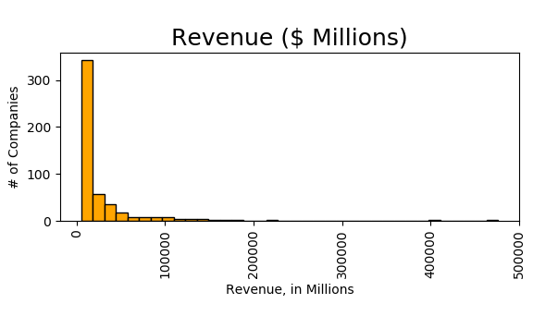
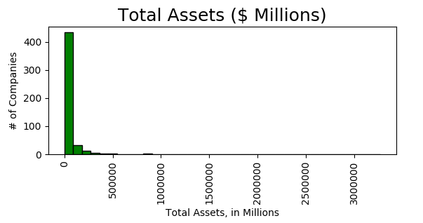
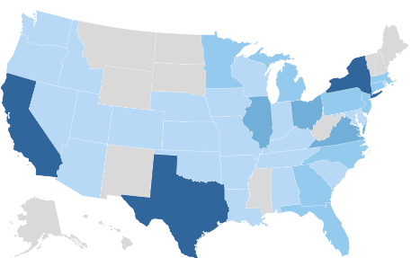
Fortune 500 Companies:
The top 500 public U.S. companies, ranked by Fortune Magazine
$ 12 trillion total revenue
$ 11 billion median revenue
#1 Company: Regions Financial Corps
$ 36 trillion total assets
$ 16 billion median assets
#1 Company: Advanced Micro Devices
Fortune 500 HQs Source: ceo.com
1

Slide 3
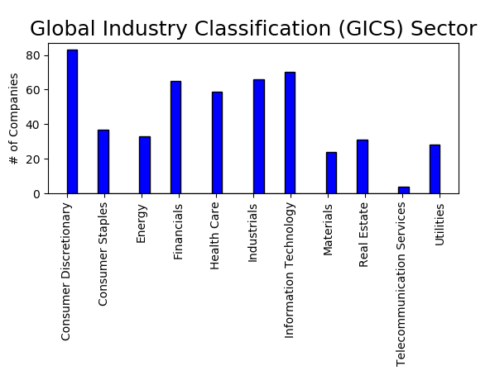
Most companies in: Consumer Discretionary,
Information Technology, Industrials, Financials, and Health Care Sectors
2

Slide 4
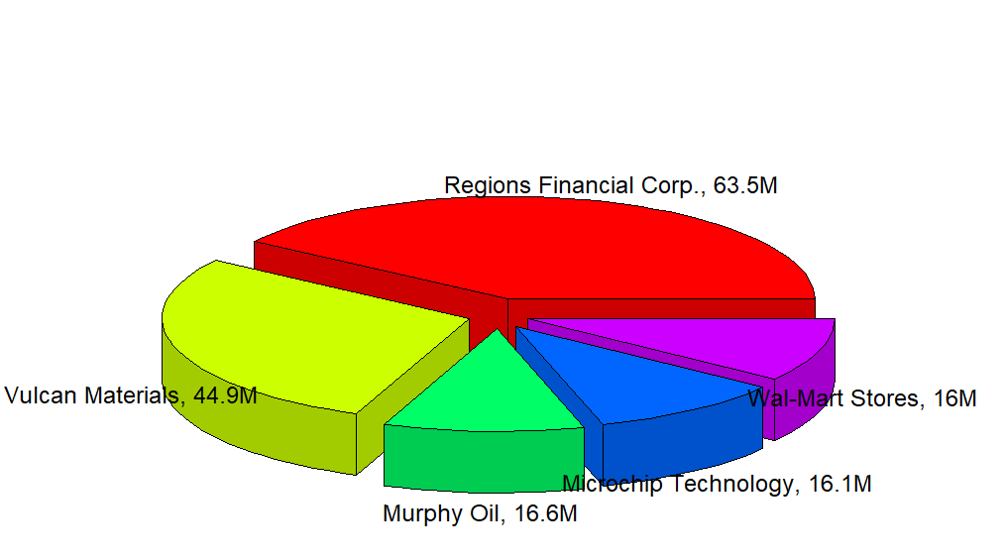
Top 5 Sources of WF Revenue: Companies
Regions Financial Corps, 63.5M
Vulcan Materials, 44.9M
Wal-Mart Stores, 16M
Microchip Technology, 16.1M
Murphy Oil, 16.6M
3

Slide 5
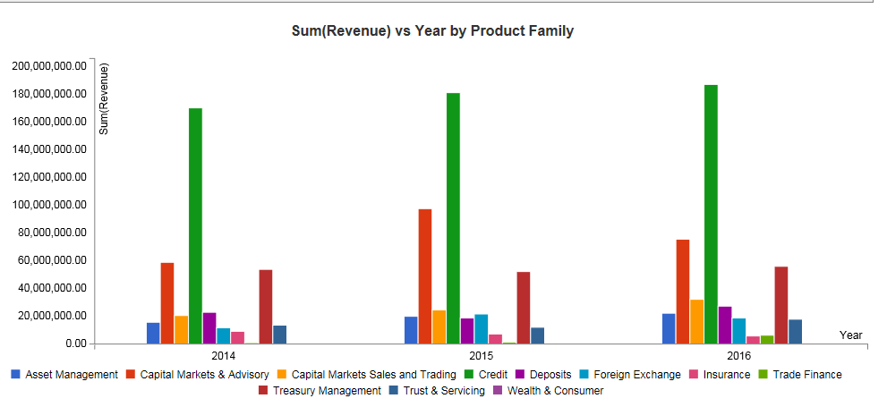
Sources of Revenue: Product family.
By far, Credit garners the most revenue
4

Slide 6
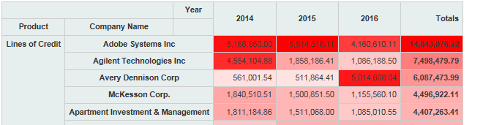
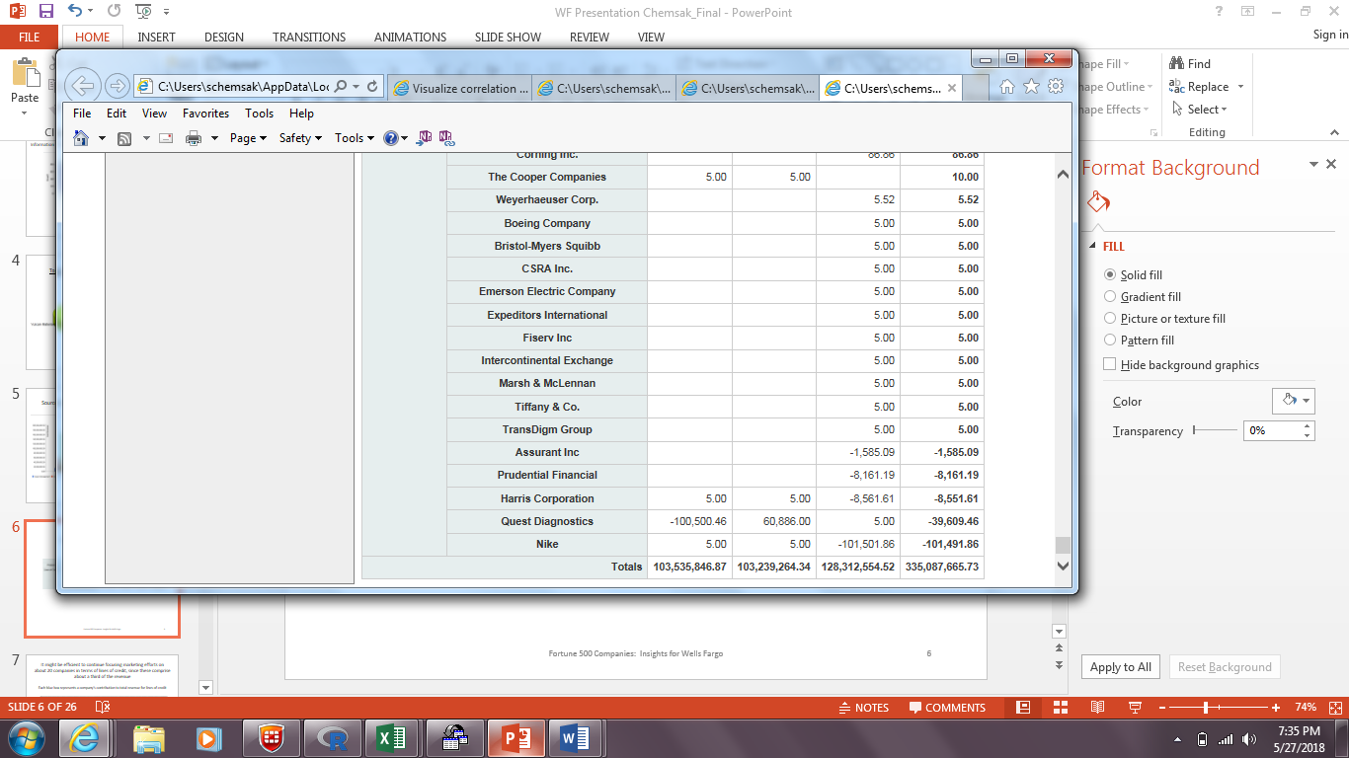
Products: Lines of Credit generates the most revenue for WF,
at over $330 million.
Top 5 Companies – Lines of Credit
Deeper red indicates higher values, by column
5

Slide 7
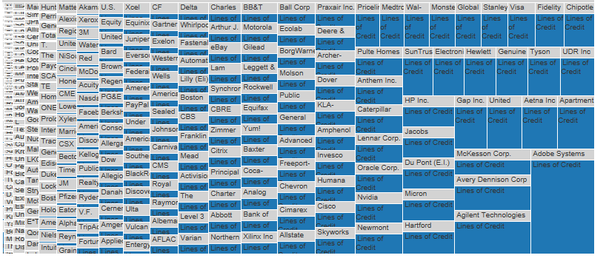
Lines of Credit: It might be efficient to focus marketing efforts on 30 or so companies.
Each blue box reflects each company’s contribution to total revenue for lines of credit: Note how a little over a third of the revenue is generated from around 30 companies.
6

Slide 8
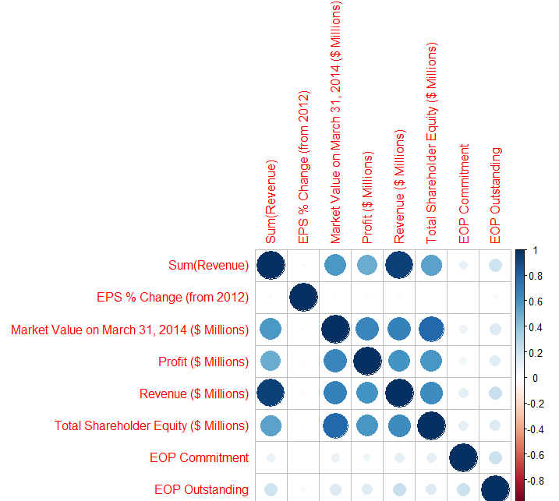
Company
Regression Model and Correlations
Share-holder Equity
Wells Fargo
WF Revenue
Profit
Market Value
Correlation
Company Revenue
Company revenue, by itself, (or with other variables above) turns out to be a powerful predictor of WF Revenue
7

Slide 10
Bonus Slide: Machine Learning Regression Decision Tree to Predict WF Revenue
A decision tree regression model was also fit to predict WF revenue using company revenue and company profit.
The average error (mean absolute error) of the model tested to create predictions on a sample of the original data was $870,000 (max revenue from any one company was about $63 million).

